Slide 1
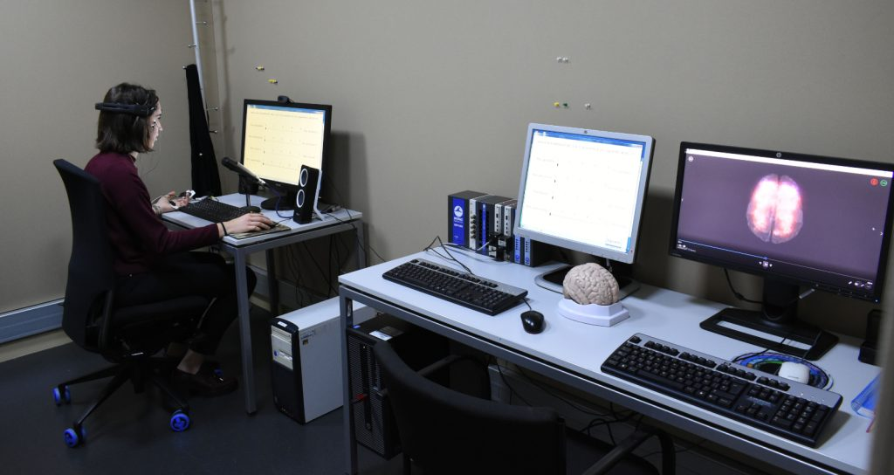
in the lab…

Slide 2
Crowd-sourced wisdom
Poll time!
Pay students for their work (no volunteers!)
Proactively, thoughtfully recruit students from diverse backgrounds
  Don’t look only at the usual markers (GPA, GRE, etc)
  Look at potential and build up their talents, help students overcome challenges
  Acknowledge and value “atypical” experience
  Incorporate explicit training for students who do not yet have necessary skills
  Clear, detailed, and dynamic lab wiki specifying all info that might otherwise be implicit (eg. what to expect on first day, work expectations/vacation time, how authorship works)
  Be flexible and understanding of students’ different life demands (e.g. caregiving)
  Be proactive about recruiting URM who may not be familiar with the idea of working in a lab, show them what is cool about Cognitive Science
  Allow students to pursue independent projects of interest to them, not just things currently interesting to the field
Poll time!

Slide 3
Crowdsourced wisdom
Poll time!
Pay students for their work (no volunteers!)
Proactively, thoughtfully recruit students from diverse backgrounds
Make sure everyone’s voice is heard
  Actively give people the tools they need to feel comfortable speaking up
  Foster and maintain an environment in which is is safe to speak up
Tools to speak up
  Give everyone explicit opportunities to share ideas and concerns
  Acknowledge and accept differences in style/temperament/culture
Safe environment
  Model treating people with respect, ensure everyone listens to ideas respectfully
  Prepare/encourage people to speak up to ensure the above (bystander training)

Slide 4
Crowdsourced wisdom
Poll time!
Pay students for their work (no volunteers!)
Proactively, thoughtfully recruit students from diverse backgrounds
Make sure everyone’s voice is heard
Encourage people to be their authentic whole self
  Be your own authentic self
  Be open about your struggles and flaws, share personal experiences
  Hold lab meetings not focused on work updates, e.g. check-ins, failures/successes, relevant events or papers to recommend, productivity tips, lab anti-racism brainstorming
  Allow time and place for relaxing group activity, such as social occasions in which culinary skills are exchanged (be mindful of potentially problematic situations)

Slide 5
Crowdsourced wisdom
Poll time!
Pay students for their work (no volunteers!)
Proactively, thoughtfully recruit students from diverse backgrounds
Make sure everyone’s voice is heard
Encourage people to be their authentic whole self
Make embracing equity and diversity an explicit core value of your lab
  Be open about support of URMM, e.g. share info on the topic on social media
  Set aside one meeting/term to talk about inclusion issues, let students lead these discussions
  Offer training and model speaking up to problematic behavior, bring people in by assuming they want to do the right thing, “We all want equality…”
  Include considerations of social justice in different aspects of lab practice -- participant recruitment, participant incentives, etc.
  ”For nearly every decisions we make in the lab now, one of the considerations is: how does this help promote social justice and if it does not help how do we change this? “

Slide 6
Thoughts?
Pay students for their work (no volunteers!)
Proactively, thoughtfully recruit students from diverse backgrounds
Make sure everyone’s voice is heard
Encourage people to be their authentic whole self
Make embracing equity and diversity an explicit core value of your lab

