Slide 1
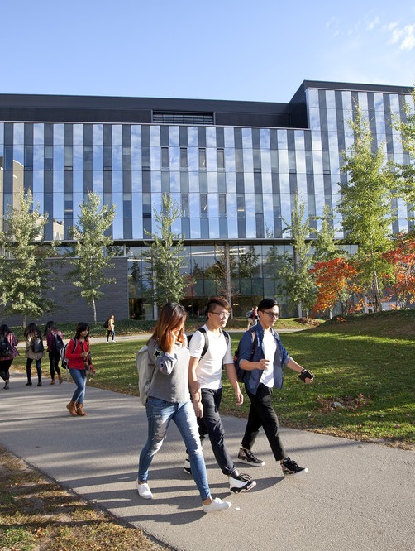


What can our discipline do?
Panel Discussant: Myra Fernandes
Department of Psychology

Slide 2
Thoughts from the Survey…
Representation
Leadership
Awards
How to make our field great?
Imposter Syndrome
Mentoring
Internationalization
What are we researching?
Who are we studying?

Slide 3
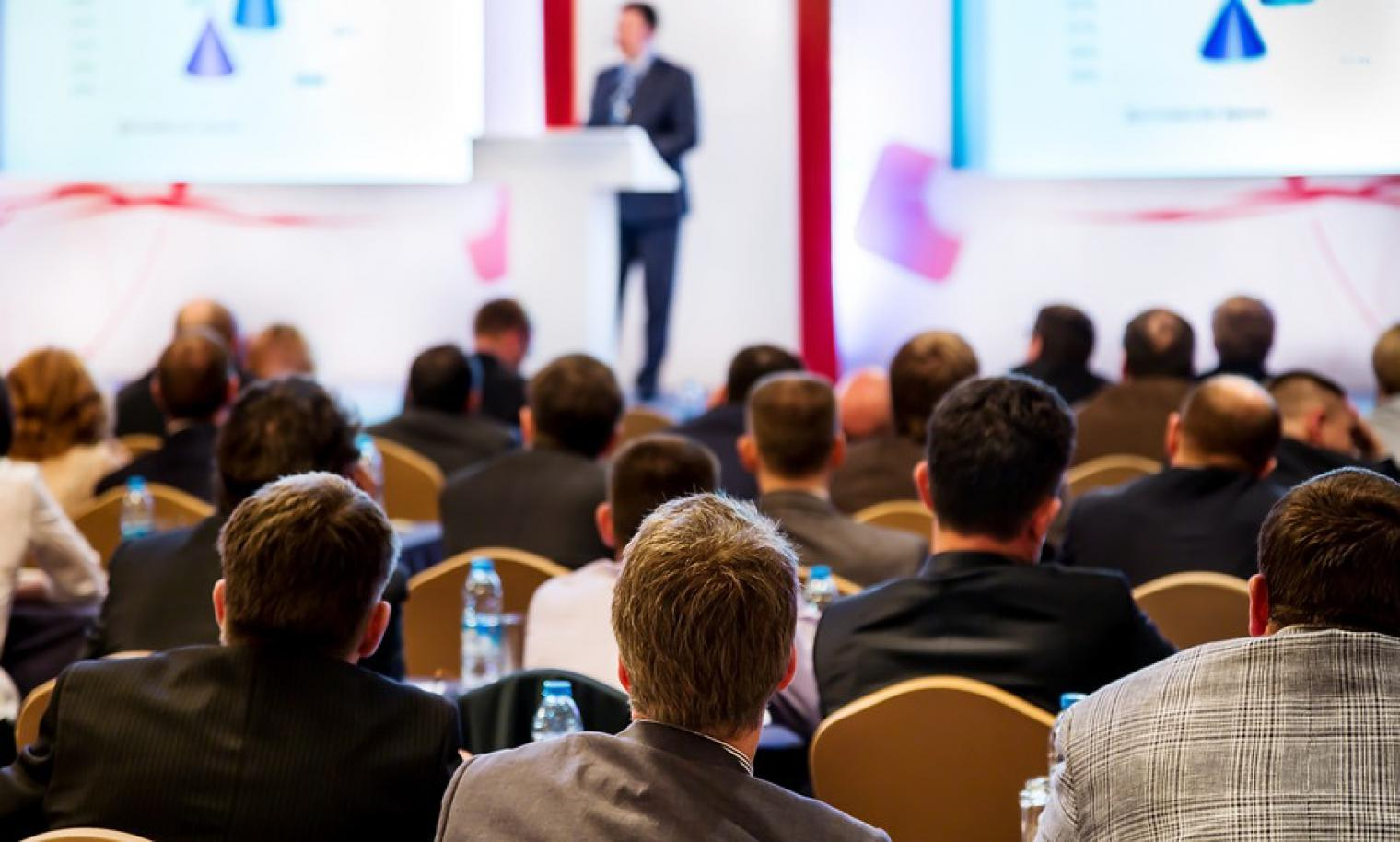

Representation
Who gets speaking time at conferences?
Who gets space in journals?

Slide 4
Poll Question…
conferences

Slide 5

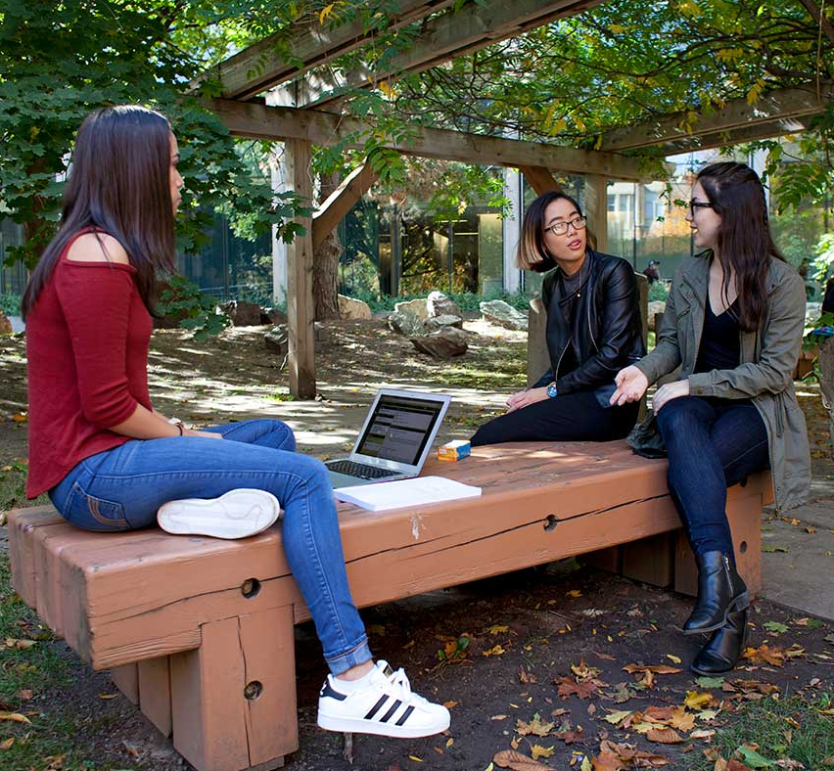
Leadership
Needed to invoke change?
How to make an impact?
Conference organisors
Departmental committees
Allow more voices

Slide 6
Poll Question…
Issues facing trainees

Slide 7


Awards
Nomination process
Selections
Grants

Slide 8
Poll Question…
Future options to consider

Slide 9
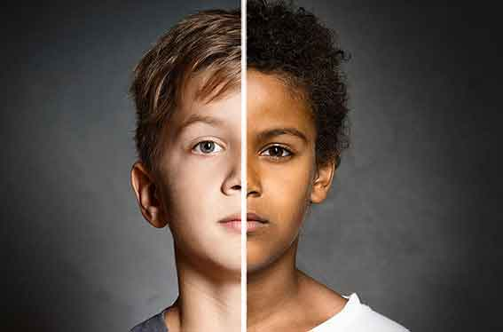

What and Who are we studying?
Biases?
  Agism
  Racism
  Gender effects
  Sex differences

Slide 10

More ideas to invoke change?
Thank You !

